Slide 1

PRACTICAL APPLICATIONS OF DEEP LEARNING
FINAL PROJECT
Team : 2
USNS: PES1201701617, PES1201701547, PES120170450,
PES1201701552, PES1201700395, PES1201700964
NAMES: MAHIMA, KAUSHAL, SHREYAS,
RAHUL, SHRINIDHI, BRUNDHA

Slide 2

PROBLEM STATEMENT / TECH OVERVIEW
“To identify the Acute brain Infarct location from a given MRI image of the patient’s brain”
Data Organizing
Data Pre-processing
CNN Modelling
Model Optimizer
Inference
Location-wise,
Merging
Cropping,
Resizing, Augmenting
Keras
IR conversion
novel data prediction
Notes:
Acute: 1Acute: 1 day - 1 week old, Infarct: dead tissue
Dataset organising - infarct location basis
Data Pre-processing - cropping, resizing, etc and Data augmenting
Only ‘DWI’ images used for training and testing the model
Cases with the same infarct location are used for the test set
Test the model on the inference set. deprived of blood (oxygen) supply day - 1 week old, Infarct: dead tissue deprived of blood (oxygen) supply

Slide 3
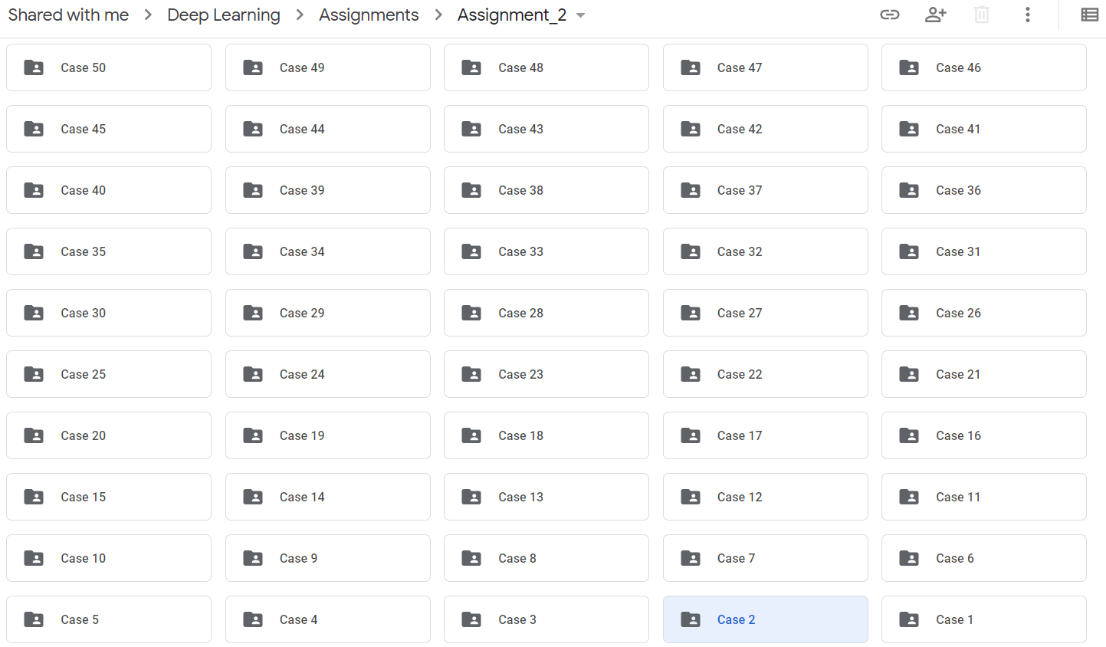
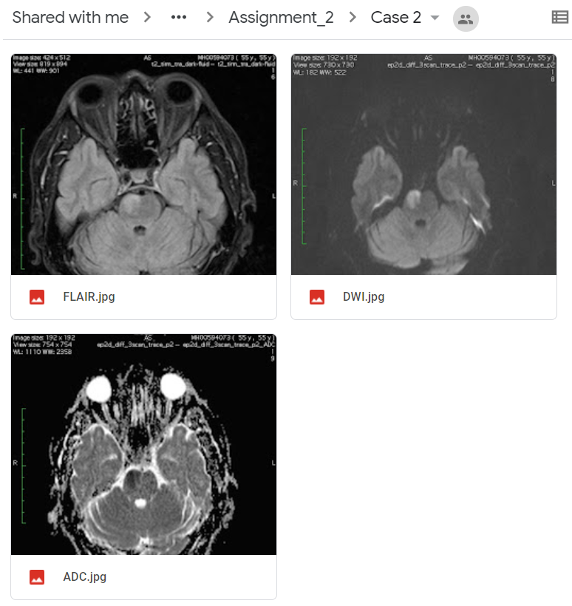
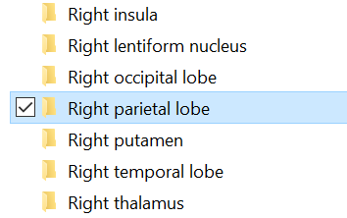
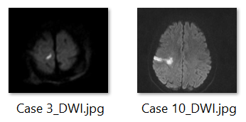
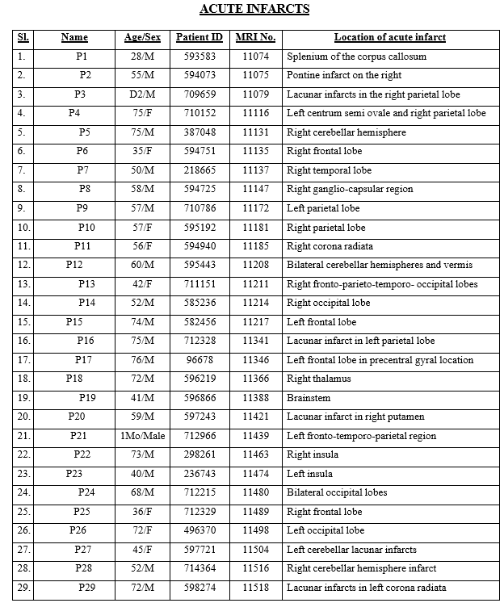
DATA GATHERING
Dataset with 50 cases (ADC, FLAIR and DWI) & PDF with location of the acute infarcts
Organized data - “CLEANED_DATA” folder
Subfolders (46) - named as infarct location
Merging similar location classes (36) - To reduce no. of output classes
Only DWI (Diffusion-Weighted Imaging) used - sensitive to acute stroke (water movements)
‘Lacunar infarct in right parietal lobe’ + ‘Right parietal lobe’ = ‘Right parietal lobe’
46 classes
36 classes

Slide 4
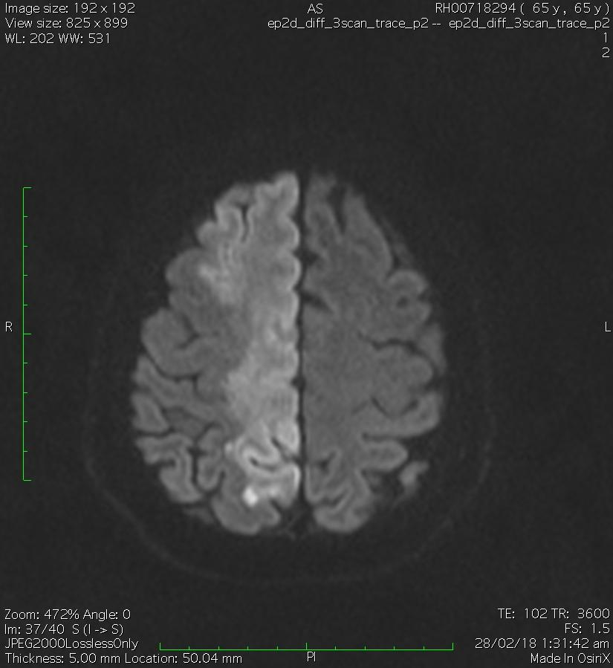
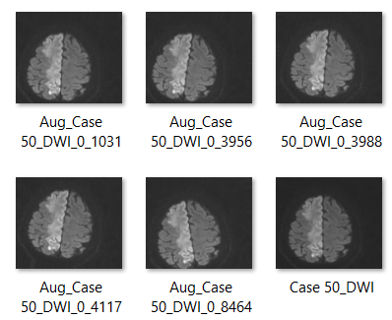
DATA PRE-PROCESSING & AUGMENTATION
Resizing & Cropping - Removing “Textual” components
Less data thus, Augmentation
Did - height, width, tilt, and shear (very less range)
Didn’t - Vertical-flip, horizontal-flip
36 classes - each contains same no. of aug images unbiased model
Resizing & Cropping
Augmentation

Slide 5
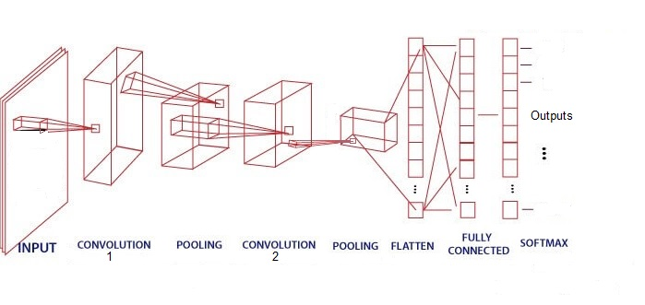
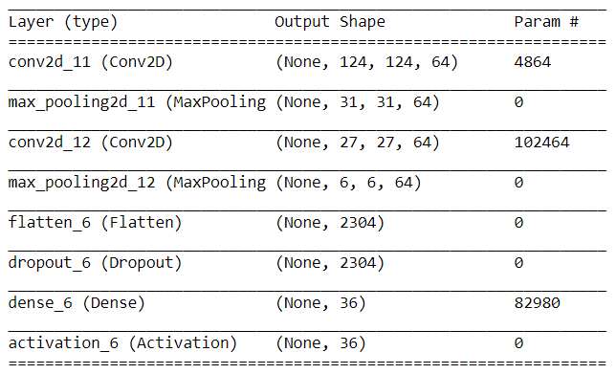
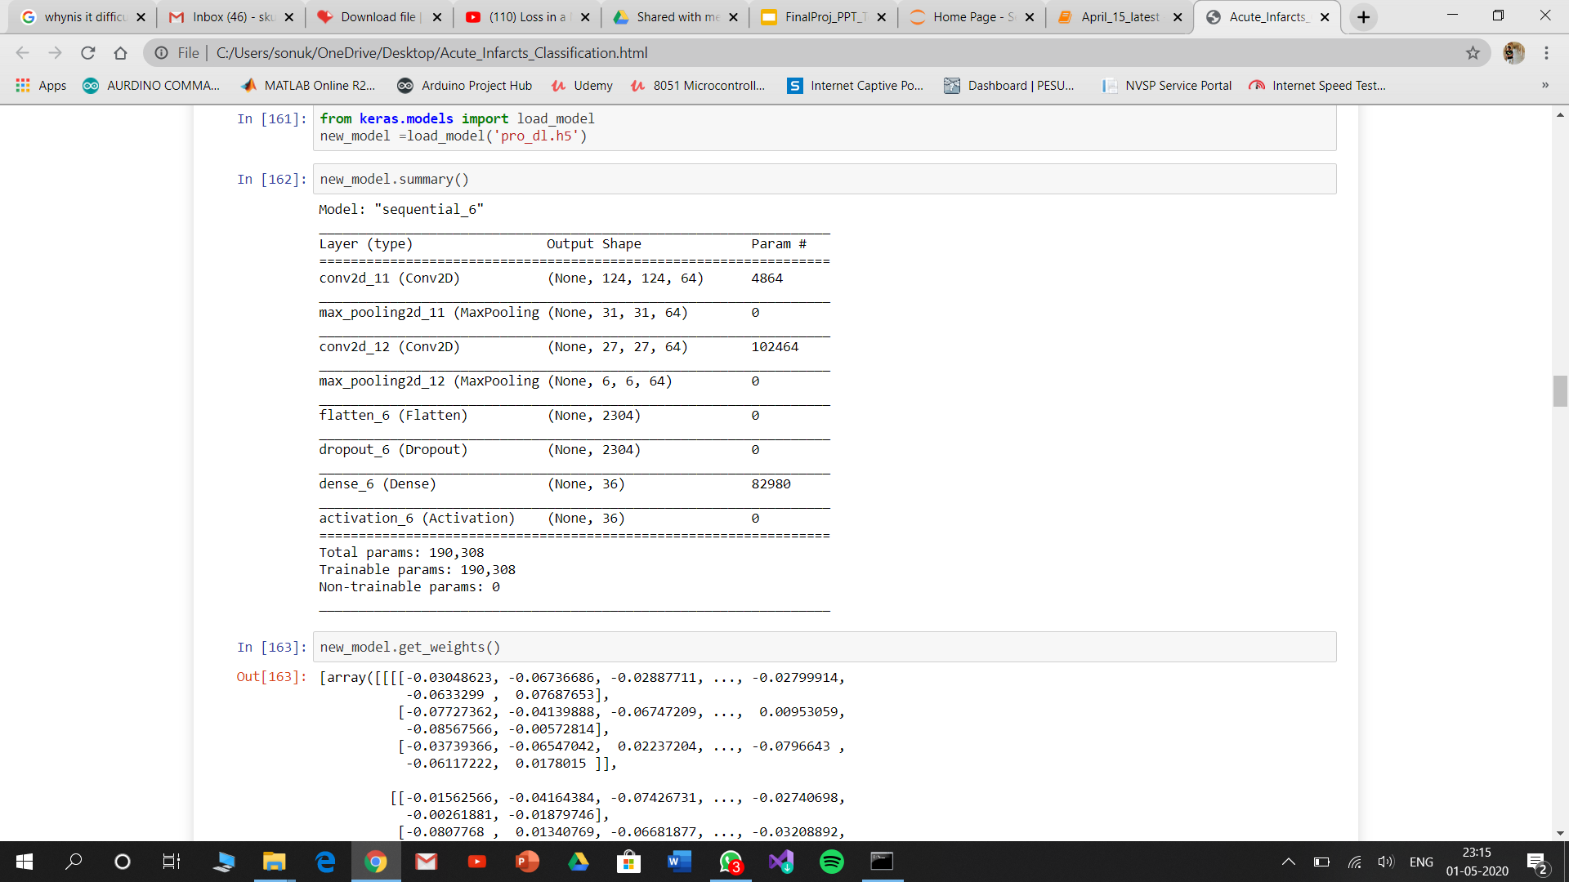
CNN ARCHITECTURE
Conv layer 1 - 64 Neurons - activation function: ReLU
First Max pooling layer - pool size: (4,4)
Conv layer 2 - 64 Neurons - activation function: ReLU
Second Max pooling layer - pool size: (2,2)
Flatten layer
Dropout layer (prevents neuron interdependencies and overfitting)
Fully Connected layer - 36 neurons
Output layer activation function: Softmax

Slide 6
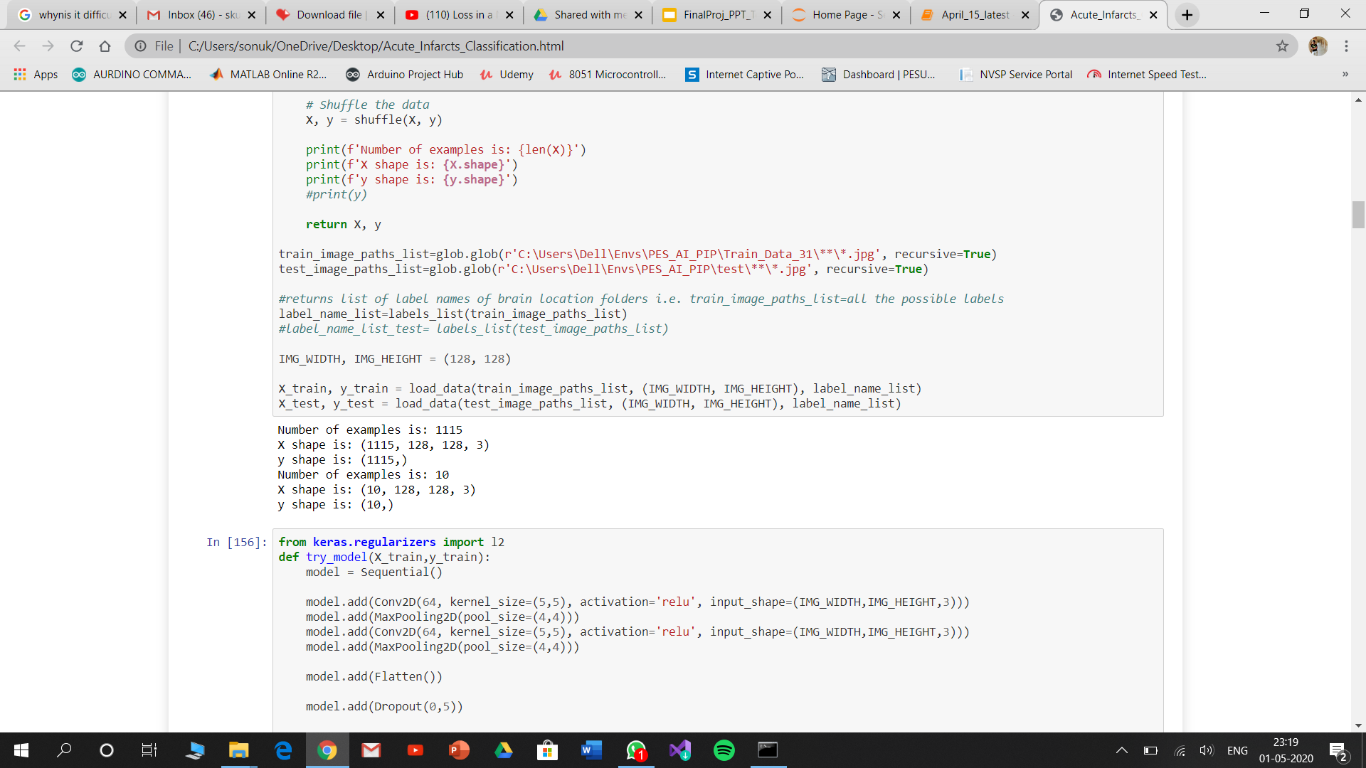
TRAIN AND TEST
After the augmentation and grouping based on location, there are 36 classes of training images and 10 of the repeated or closely located brain scan images are given to the test set.
Training and validation:
Test:
In the Training Dataset we have considered a 70-30 training-validation split
Train on: 781 samples
Validate on: 334 samples

Slide 7
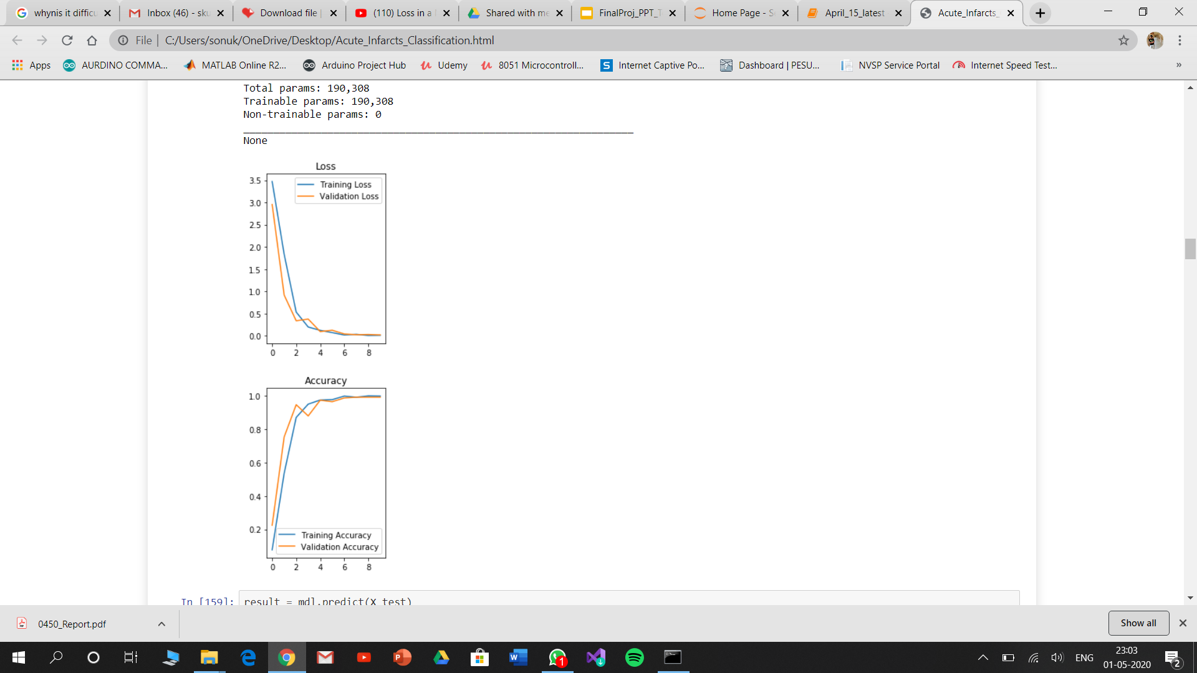



ACCURACIES AND TWEAKS
Tweaks
No. of epochs (8,10,12)
Filter size ( (4,4), (5,5))
Dropout (0.2,0.5)
Input resize (128, 128, 3) values
Degree of variation in Augmented images (10, 20, 30)
Training loss: 0.0094
Val. loss: 0.0190
Training accuracy: 0.9978
Val. accuracy: 0.9910
Test set:
Inference set:
Numbers = Index of class folders when sorted alphabetically (4/10 = 40%)
Around 6-7 out of the 36 inference cases were predicted correctly (16.7% - 19.4%)

Slide 8
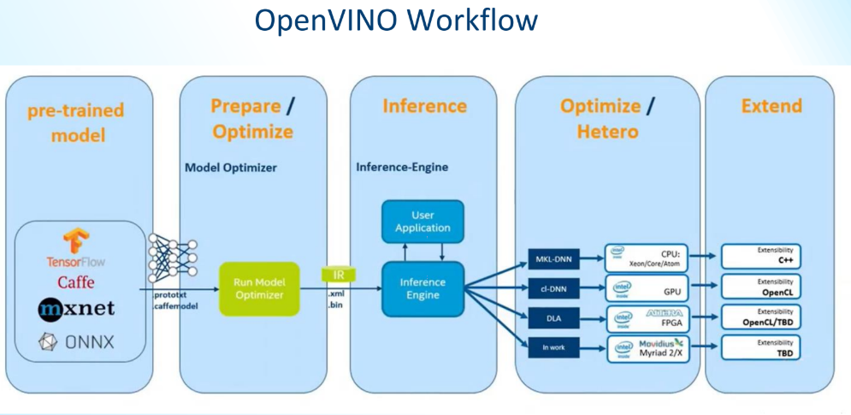
INTEL MODEL OPTIMIZER
Model optimizer provides an Intermediate Representation (IR) of the network which can be read, loaded and inferred with the inference engine.
Optimization techniques:
Quantization - reduction of precision of weights and biases
Freezing - randomly freezing layers from training to fine tune the other layers.
Fusion
Workflow to convert the keras model to OPENVINO model and make a prediction:
Save the Keras model as a single .h5 file
Load the .h5 file and freeze the graph to a single Tensorflow .pb file
Run the OPENVINO mo_tf.py script to convert the .pb file to IR model (xml and bin)
Load the model xml and bin file with OPENVINO inference engine and make a prediction.

Slide 9
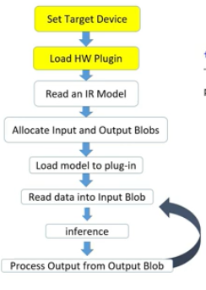
SCRIPT TO RUN THE MODEL WITH INTEL OPENVINO
Workflow for using the Inference Engine API
Create an Inference Engine core object
Read the Intermediate Representation obtained from optimizer.
Prepare the inputs and outputs format
Load the network to the plugin
Call the inference API

Slide 10

OBSERVATIONS / CONCLUSION
Best accuracy of the model : For epochs = 9, dropout = 0.3, batch size = 20)
  Training set: 98 % Validation set: 98 %
  Test set: 40 % Inference set: 21- 22%
Model performed well with the given small dataset. However, larger dataset is required for better prediction.
Epochs over 10 cause overfitting and below 8 cause underfitting on the current model.
Dropout can be used to reduce overfitting.
Model predicts some cases semi-correctly
In conclusion,
              Intel Distribution of OpenVINO toolkit is an extremely useful framework to optimize the
              models and execute computer vision using deep learning on edge systems.

Slide 11

THANK YOU!

